Slide 1
GESTURE CONTROLLED MEDIA PLAYER
Under the guidance of
Dr.R.Rajasekhar
Assistant Professor,Dept of CSE
Project Team
B.Sudha Rani-18001A0503
D.Jayaprada-18001A0504
P.Madhavan-19005A0501

Slide 2
01
Introduction
02
Existing System
03
Proposed System
04
Workflow
CONTENTS
05
Libraries Used
06
User Interface
07
Output
08
Conclusion
09
References

Slide 3
Introduction
Gesture Controlled Media player is used to operate the functions of VLC Media player.
This application uses the webcam to capture gestures by the user and perform basic operations such as play,pause,forward, backward,volume up,volume down.

Slide 4
Existing System
The existing system operates the functions of VLC Media player such as play and pause using Convex hull and Deep Learning.
The accuracy in detecting hand gesture is low using the above techniques.

Slide 5
Proposed System
The proposed system is used to operate the functions of vlc media player using OpenCV and Mediapipe.
OpenCV is used for image processing and performing computer vision tasks. It is an open source library.
Mediapipe is the library which detects hand and tracks the position of the hand more accurately.

Slide 6
Workflow
User
Webcam
Which Gesture?
Play
Pause
Forward
Backward
Volume Up
Volume down

Slide 7
Libraries Used
OpenCV:To capture the hand gesture fromthe webcam .
Mediapipe:To detect the hand landmarks from the gesture.
Pyautogui:To perform the suitable function of VLC Media Player for the suitable gesture.

Slide 8
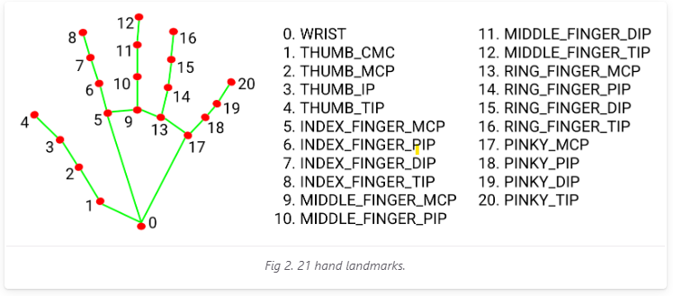
How Media Pipe detects hands?

Slide 9
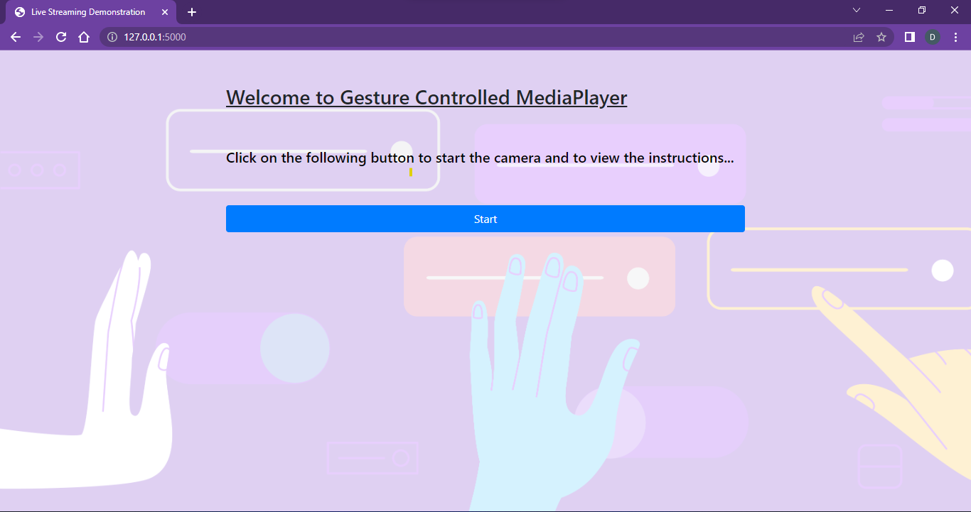
User interface

Slide 10
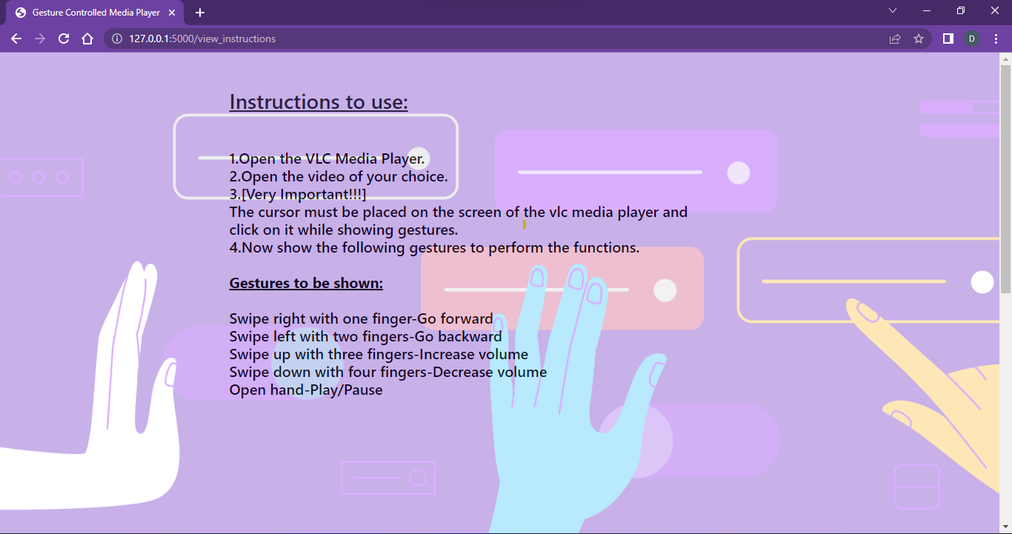
User Interface

Slide 11
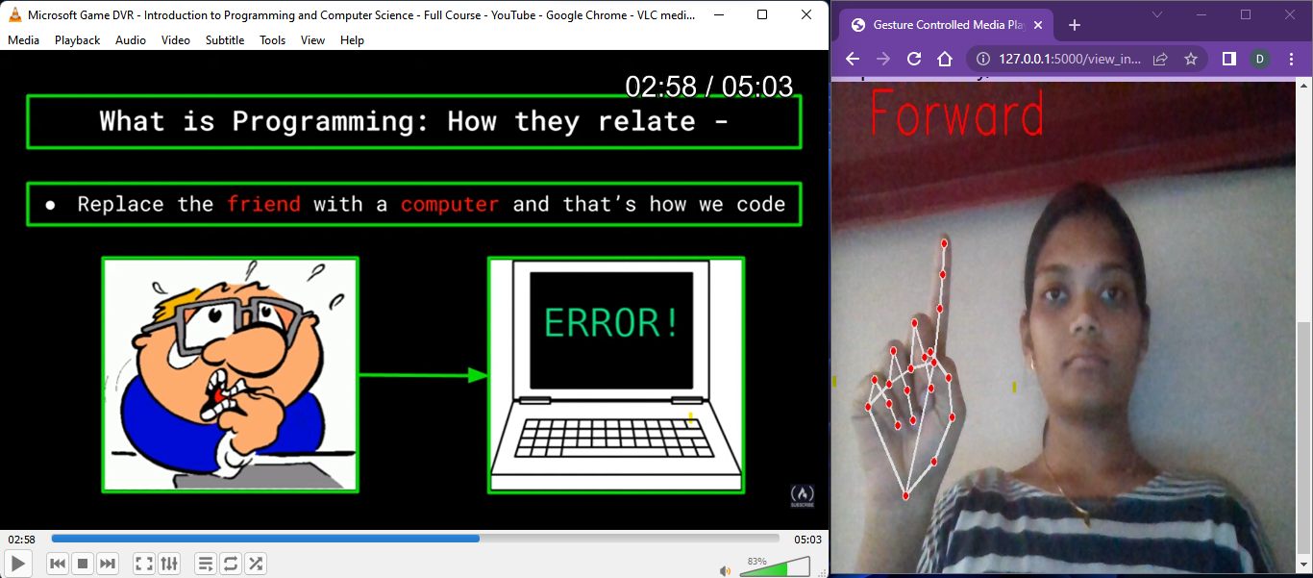
Forward Action
Swipe Right with One finger –Go Forward

Slide 12
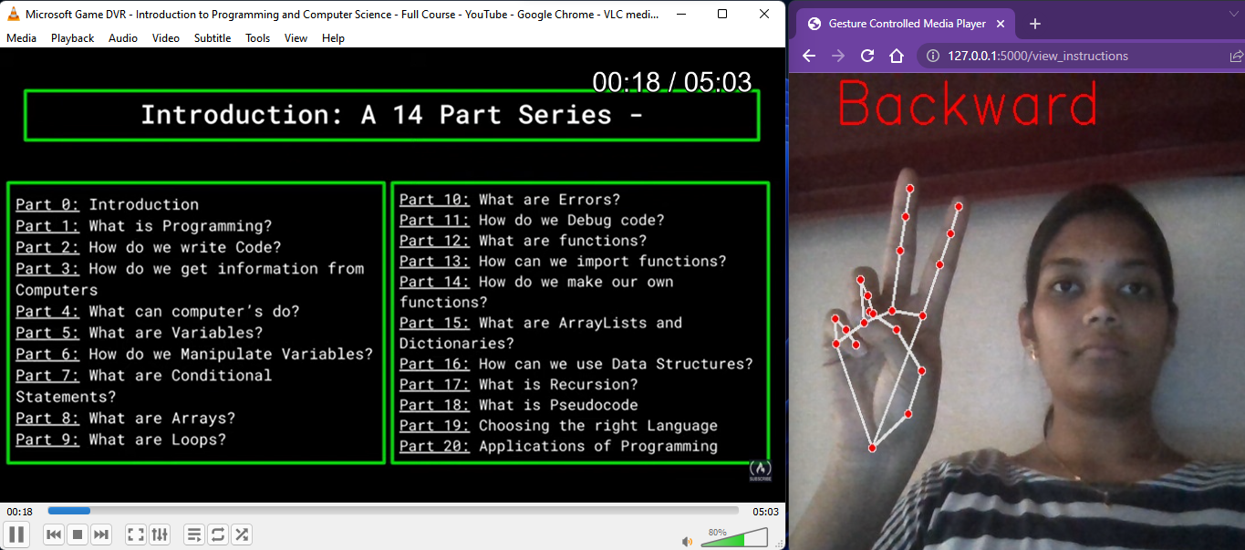
Backward Action
Swipe Left with Two fingers –Go Backward

Slide 13
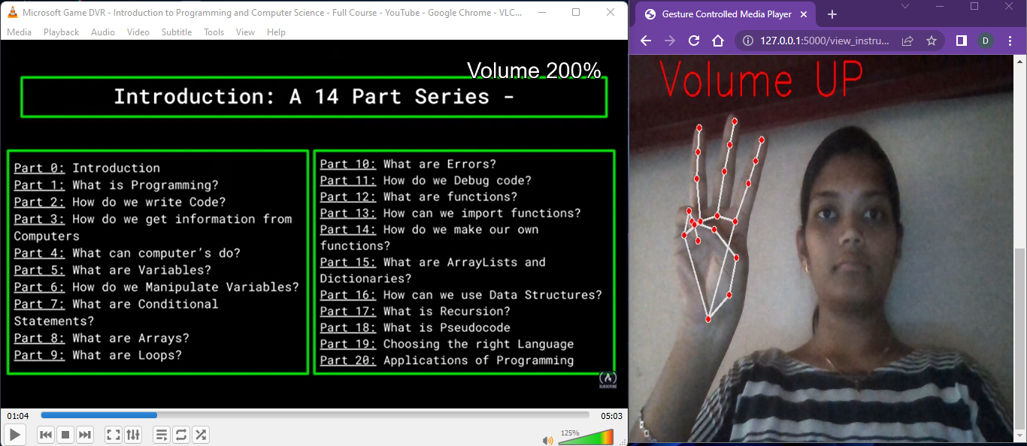
Volume Up
Swipe Up with Three fingers –Volume Up

Slide 14
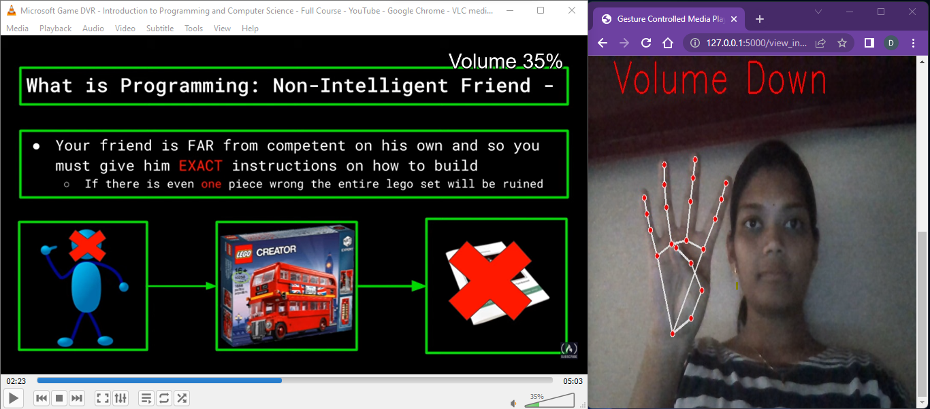
Volume Down
Swipe Down with Four fingers –Volume Down

Slide 15
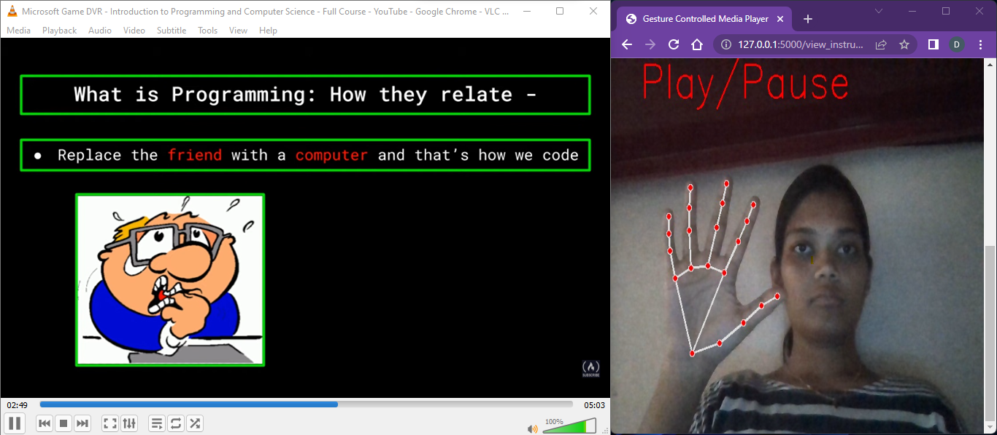
Play/Pause
Show the palm -Play/Pause

Slide 16
CONCLUSION
The main aim of the project Gesture Controlled Media player system using Python and OpenCV, which is easy to use and it will help you to control the media player by using Hand Gestures.
It provides accurate interaction between human and computer based on gestures by the User. The gesture would serve as the direct command for operations such as play, pause, volume up/down, forward and backward based on the user’s gestureon the screen.

Slide 17
REFERENCES
[1] E. Joy, S. Chandran, C. George, A. A. Sabu and D. Madhu, "Gesture Controlled Video Player A Non-Tangible Approach to Develop a Video Player Based on Human Hand Gestures Using Convolutional Neural Networks," 2018 Second International Conference on Intelligent Computing and Control Systems (ICICCS), 2018, pp. 56-60, doi: 10.1109/ICCONS.2018.8662901.
[2]Rautaray, Siddharth & Agrawal, Anupam. (2019). A Vision based Hand Gesture Interface for Controlling VLC Media Player. International Journal of Computer Applications. 10. 10.5120/1495-2012.

Slide 18
THANK YOU

